Slide 1
CABI Immersive Training
Deep Learning for Demand Forecasting
Day 1

Slide 2

About Jeff Heaton
VP, Data Science, RGA
Adjunct Instructor, Washington University
YouTuber (70K Subscribers)
Senior Member, IEEE
Fellow, Life Management Institute
M.IM. Information Management, Washington University
Ph.D. Computer Science, Nova Southeaster University

Slide 3
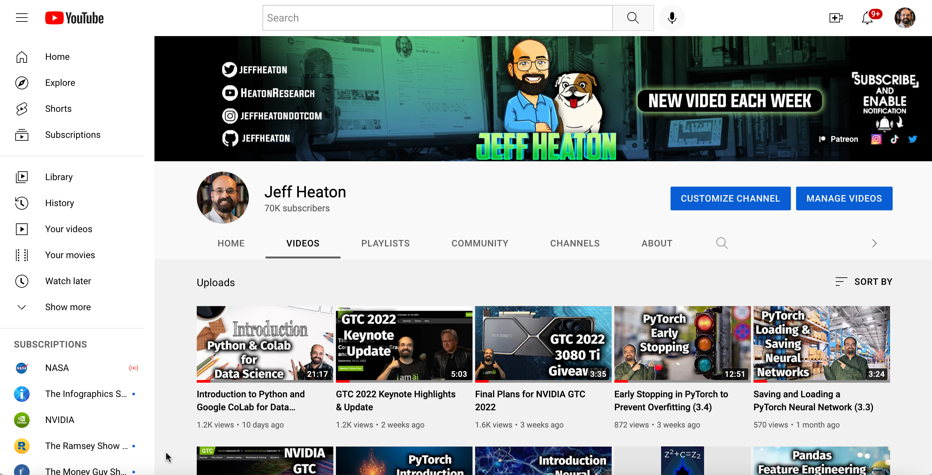
Jeff’s YouTube Channel
More here

Slide 4
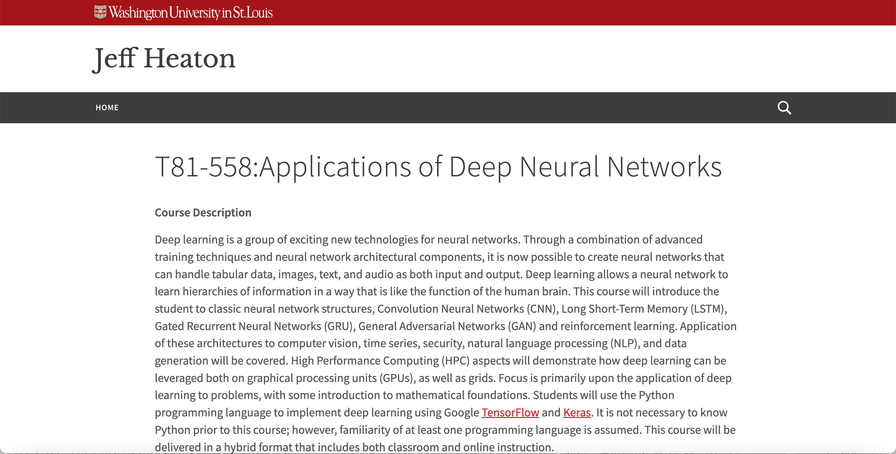
Jeff’s Deep Learning Course at Washington Univ
More here

Slide 5
Deep Learning & Demand Forecasting Experience
Sara Lee Corporation (Earth Grains Bakery)
Bread and dough scheduling across ~15 regional bakeries
RGA
Lapse Modeling
Propensity Models

Slide 6
Schedule
Day 1: Forecasting Demand from Tabular Time Series Data
Example: Exploratory Data Analysis (EDA)
Example: Univariate Forecast
Lunch 12-1 PM
Example: Seasonality and Trend Aware Forecast
Day 2: Forecasting Demand from
Example: Natural Language Processing Forecast
Example: Computer Vision Forecast
Lunch 12-1 PM
Meta Prophet

Slide 7
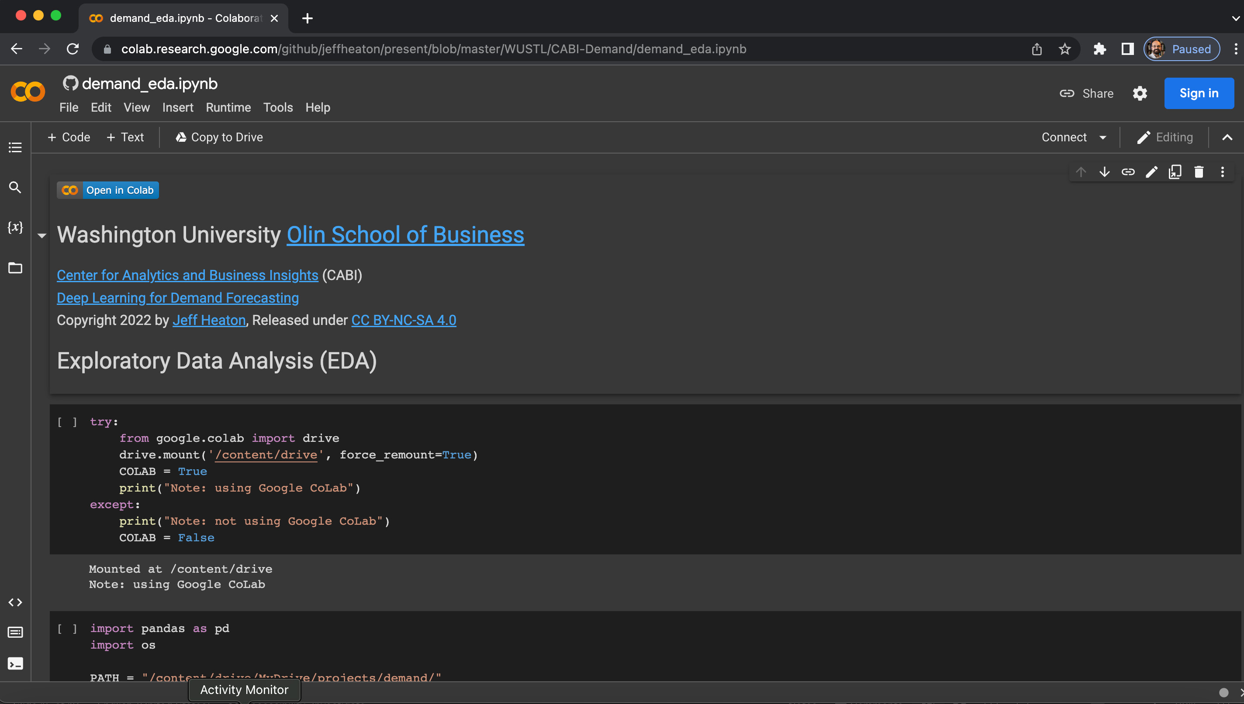
Google CoLab

Slide 8
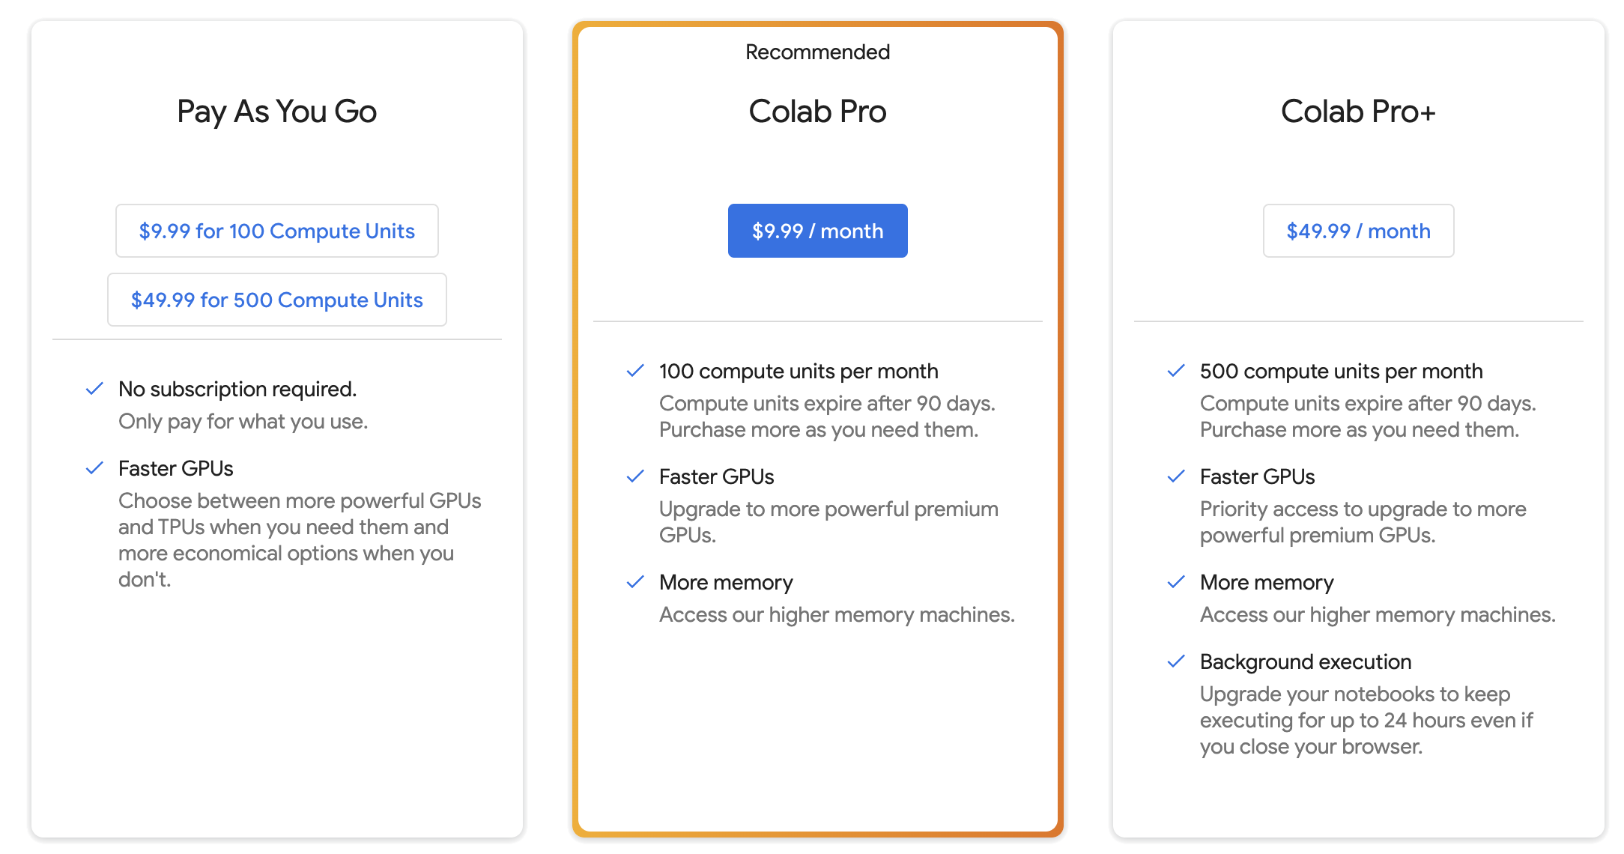
Google CoLab Levels

Slide 9
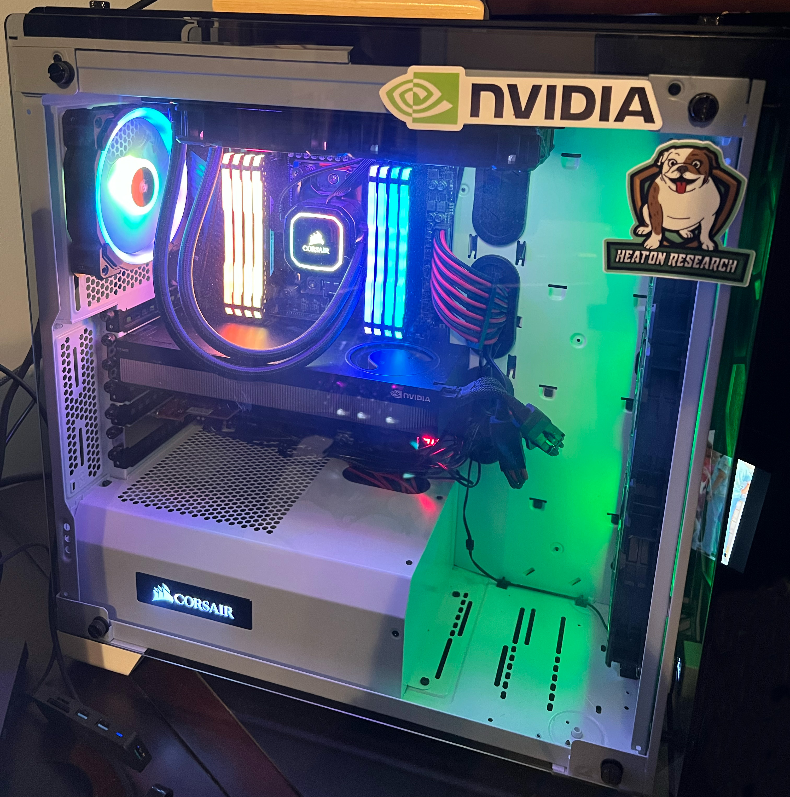
GPUs
High end desktop w 48GB GPU
128 GB Memory

Slide 10

Why Python?
Python has become the standard for general purpose machine learning.
Software engineers use Python for a wide range of tasks, from websites to embedded systems.
Python has a large community of machine learning libraries available.
Alternatives
R
Julia

Slide 11
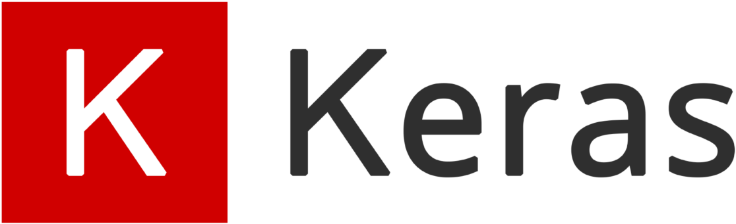
Why Keras?
Supported by Google
Usually requires less code than PyTorch
Usually less flexible than PyTorch, particularly for research.
JAX is Google’s answer to PyTorch
Alternatives
PyTorch
JAX

Slide 12
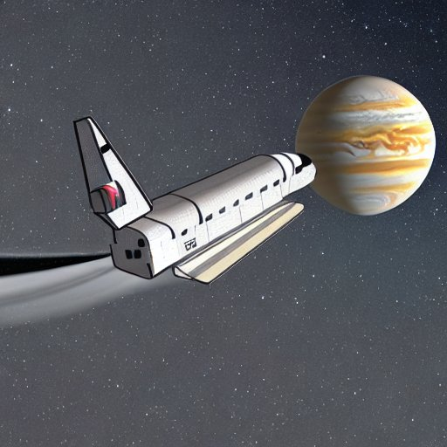
Example: Google CoLab
https://tinyurl.com/26dcemr3

Slide 13

What is Demand Forecasting?
Making future estimations in relation to customer demand over a specific period.
Consider historical data and other analytical information to produce the most accurate predictions.
Types of Demand Forecasting:
Active and Passive
Short and Long Term
Internal and External
Macro and Micro

Slide 14
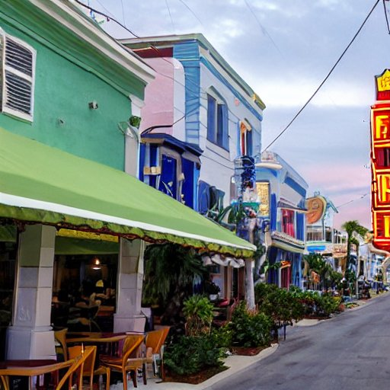
Introducing the Dataset
Forecast demand for six beachfront restaurants.
Ft. Lauderdale, FL, USA.
Structured Data
Unstructured Data
Introduction to Neural Networks for time series demand forecasting.

Slide 15
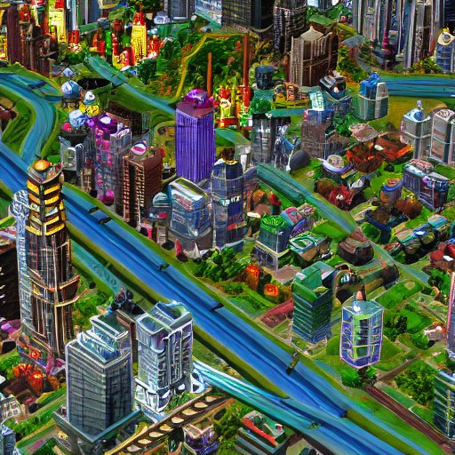
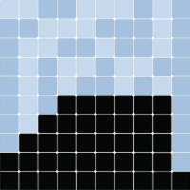
Simulated City
Multi Agent Modeling
Data create with: Mesa

Slide 16
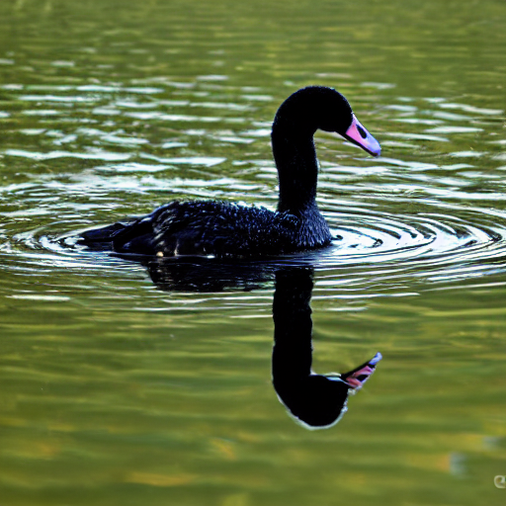
No Black Swan Events
Data from Jan 1, 2019 to Dec 31, 2021
Dates only specify seasonality
No pandemics
No wars
No market conditions
Holidays matter

Slide 17
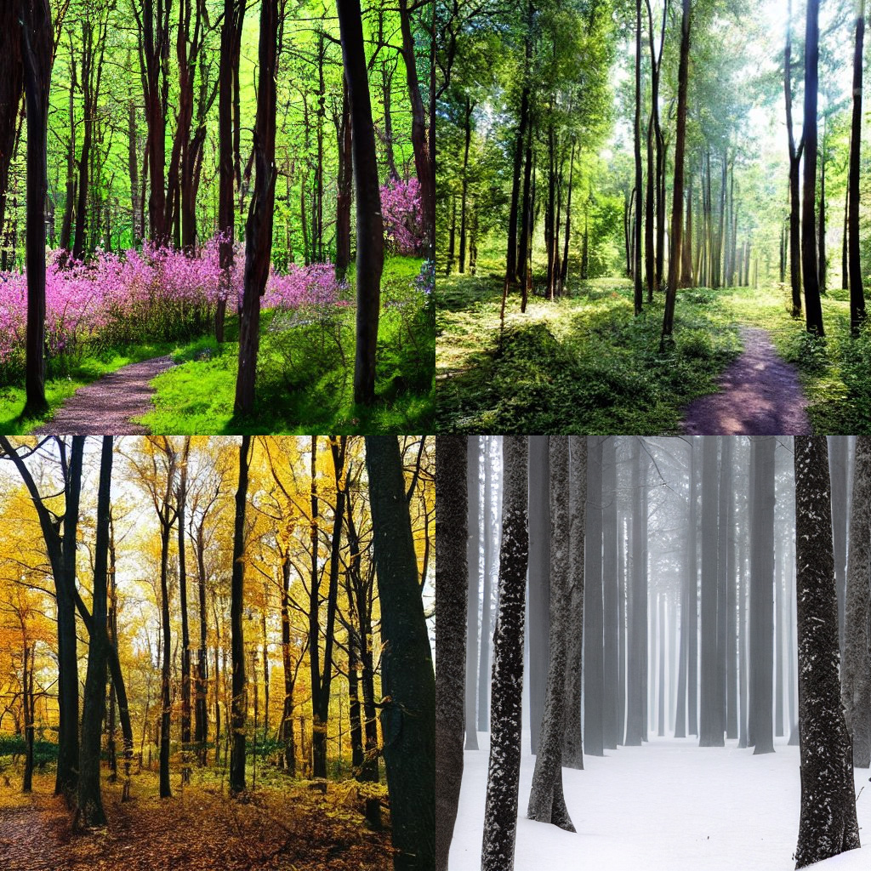
Seasonality

Slide 18
Structured Tabular Data
Three tables provided
Four restaurants (resturants.csv)
100 Food Items (items.csv)
Sales timeseries training data (sales_train.csv)

Slide 19
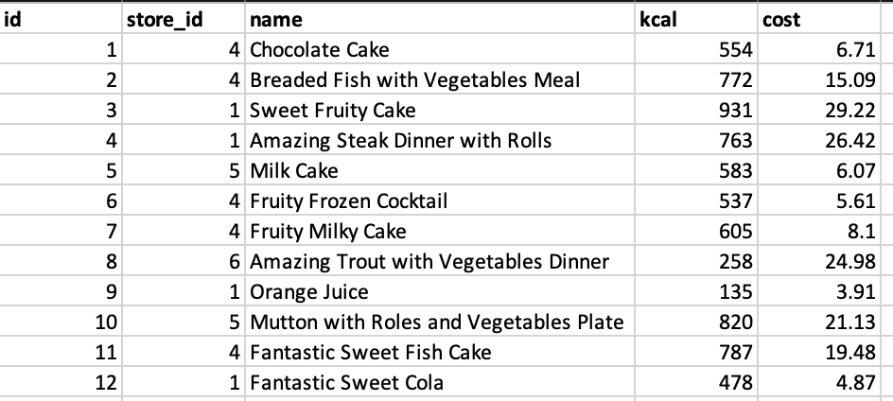
Food Item Data

Slide 20
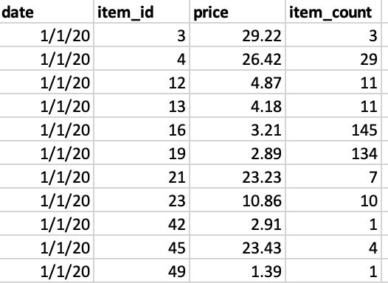
Sales Data

Slide 21
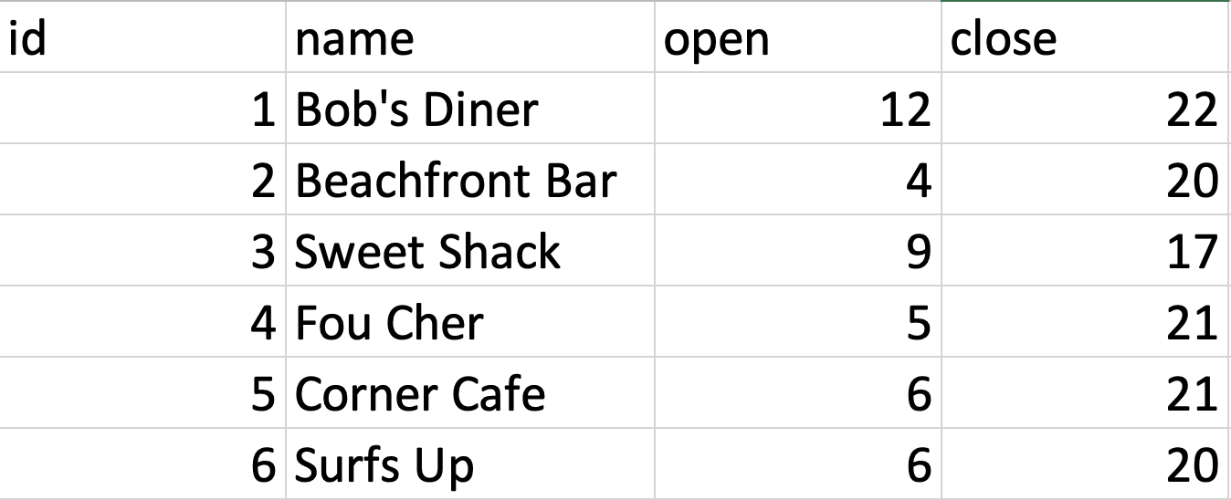
Restaurants

Slide 22
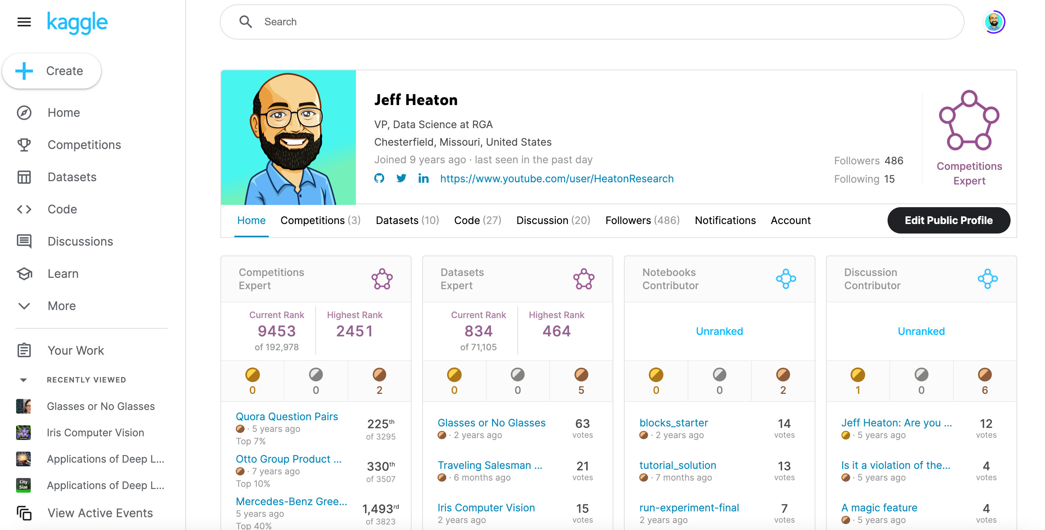
Kaggle
More here

Slide 23
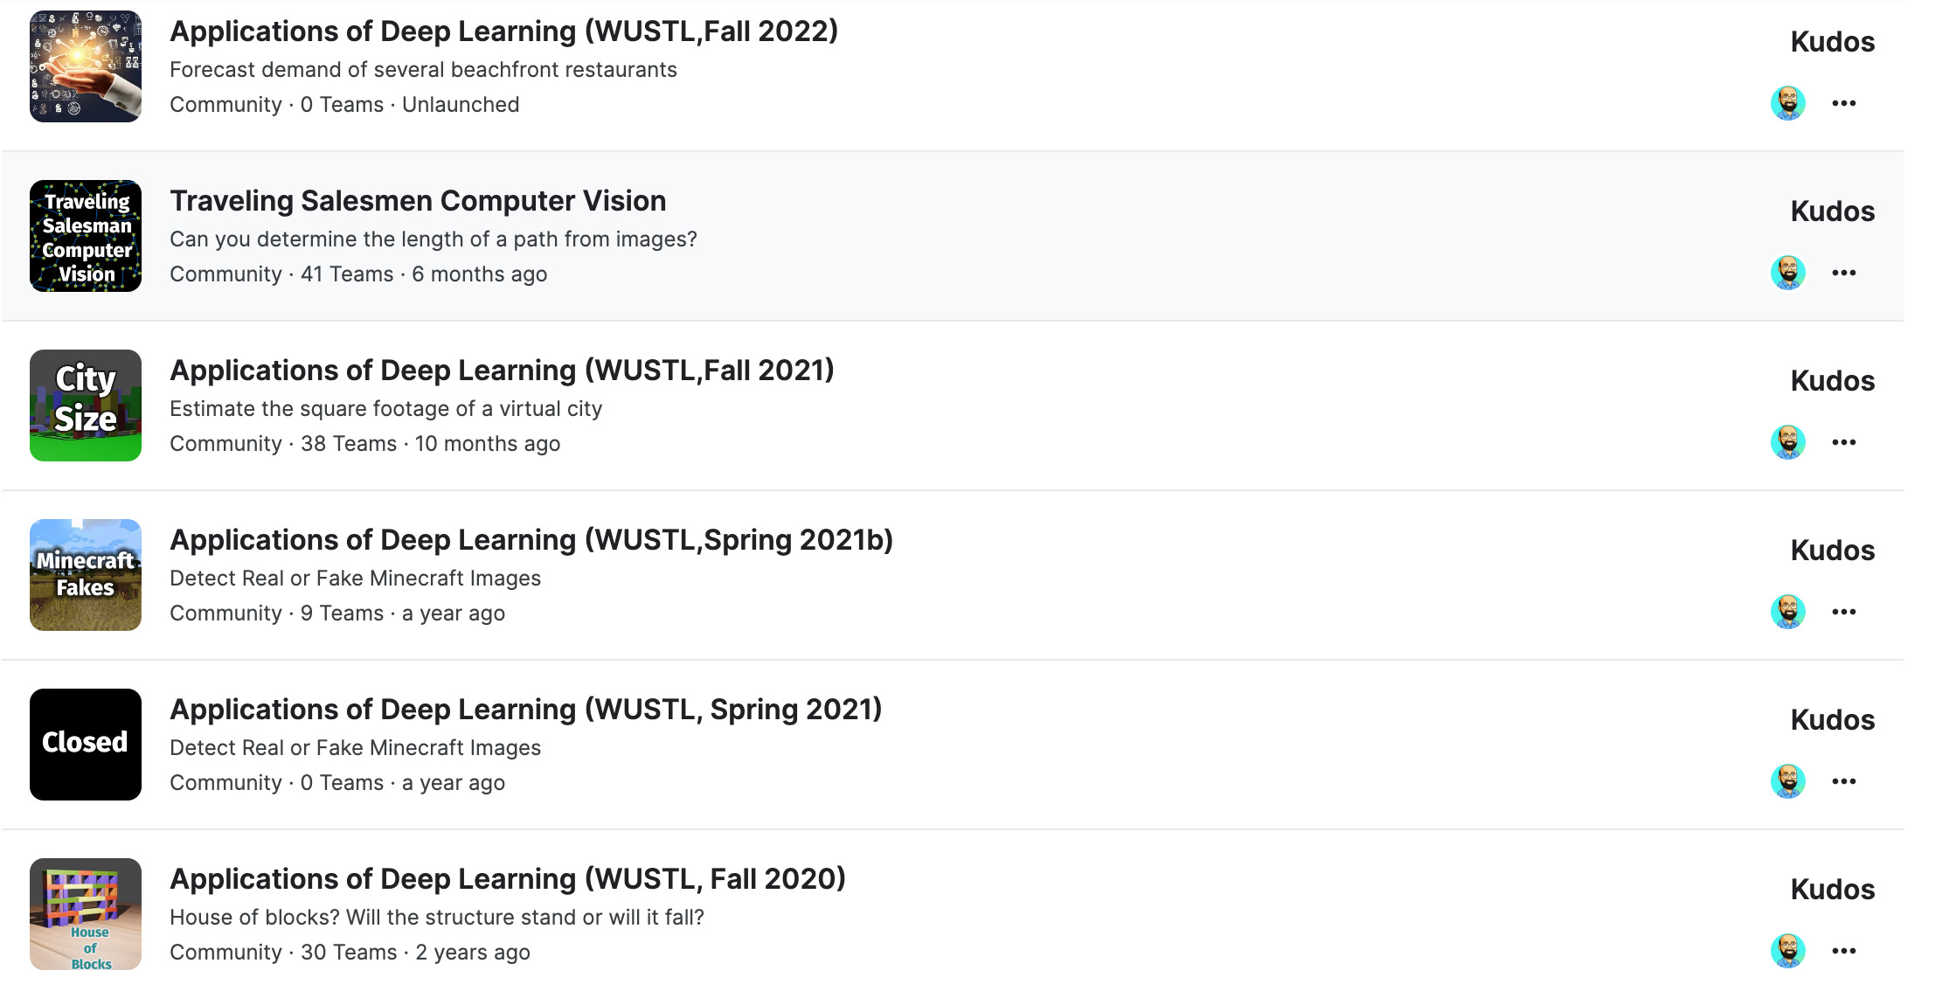
Kaggle Competitions
More here

Slide 24
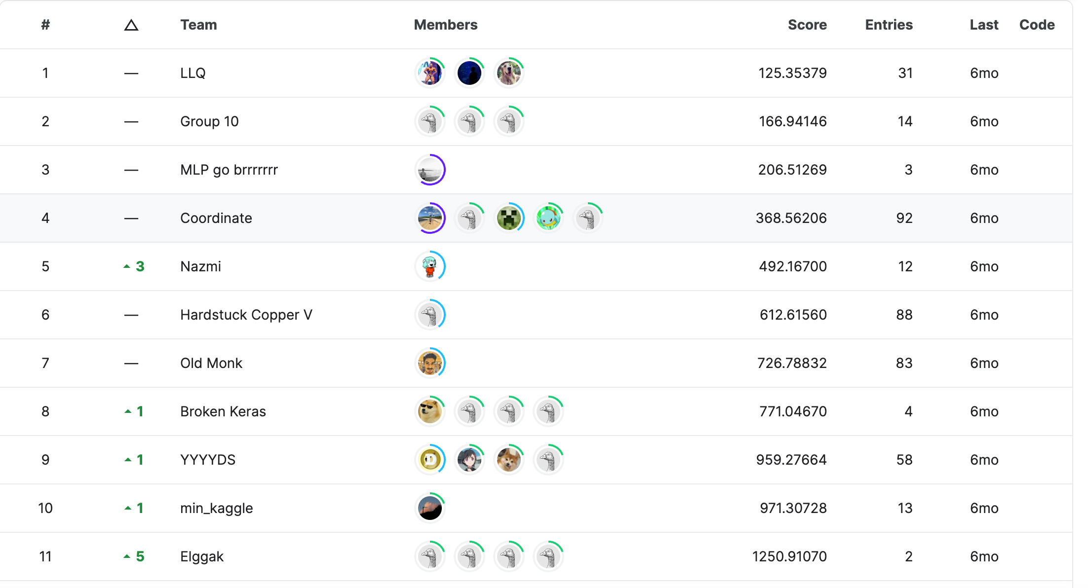
A Kaggle Leaderboard
More here

Slide 25
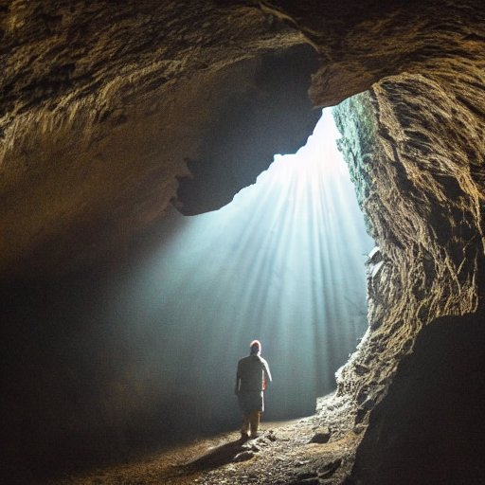
Exploratory Data Analysis (EDA)
Exploratory Data Analysis (EDA) Demonstration and Lab

Slide 26
Example: Exploratory Data Analysis (EDA)
https://tinyurl.com/26dcemr3

Slide 27

Lab #1: Exploratory Data Analysis (EDA)
https://tinyurl.com/26dcemr3

Slide 28

Univariate Forecast
Convolutional Neural Network
Sales volume only

Slide 29
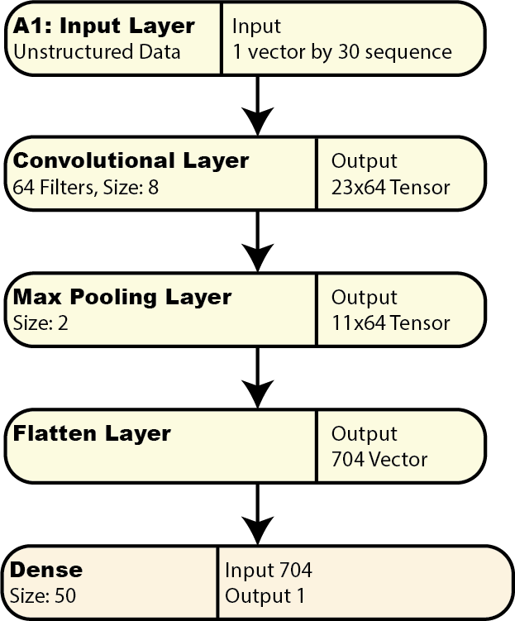
Univariate Neural Network Structure

Slide 30

Convolutional Neural Networks (CNN) for Computer Vision

Slide 31
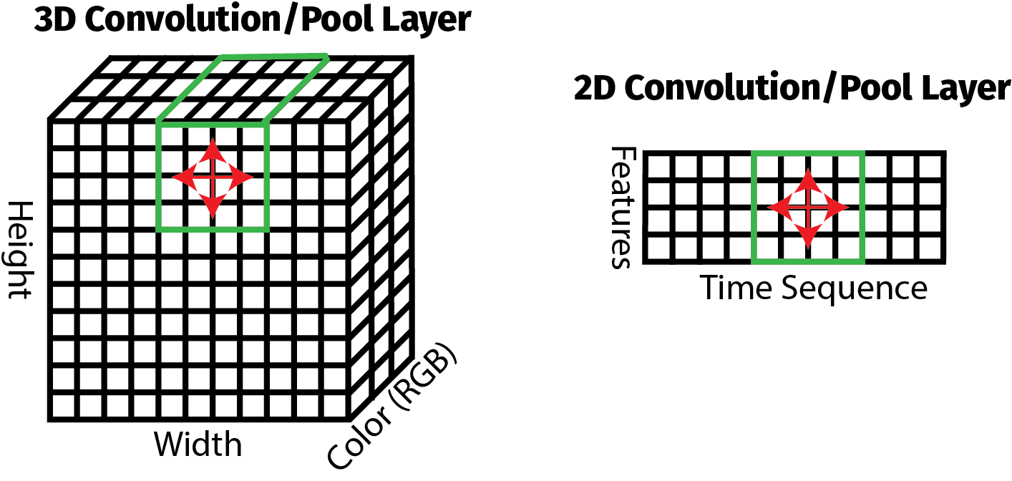
Max Pooling and Convolutional Layers

Slide 32
2D (time series) vs 3D (images) for CNN’s
Dimension | 3D CNN | 2D CNN
x | Image width | Sequence size
y | Image height | Feature/Attribute count
z | Image colors (RGB, size 3)

Slide 33
Creating Sequences
t | t+1 | t+2 | t+3 | t+4 | t+5 | t+6 | t+7 | t+8 | t+9 |  | t+10
1 | 2 | 3 | 4 | 5 | 6 | 7 | 8 | 9 | 10 |  | 11
2 | 3 | 4 | 5 | 6 | 7 | 8 | 9 | 10 | 11 |  | 12
3 | 4 | 5 | 6 | 7 | 8 | 9 | 10 | 11 | 12 |  | 13
4 | 5 | 6 | 7 | 8 | 9 | 10 | 11 | 12 | 13 |  | 14
5 | 6 | 7 | 8 | 9 | 10 | 11 | 12 | 13 | 14 |  | 15
16 | 17 | 18 | 19 | 20 | 21 | 22 | 23 | 24 | 15 |  | 16
17 | 18 | 19 | 20 | 21 | 22 | 23 | 24 | 25 | 26 |  | 17
18 | 19 | 20 | 21 | 22 | 23 | 24 | 25 | 26 | 27 |  | 18
19 | 20 | 21 | 22 | 23 | 24 | 25 | 26 | 27 | 28 |  | 19
20 | 21 | 22 | 23 | 24 | 25 | 26 | 27 | 28 | 29 |  | 30

Slide 34
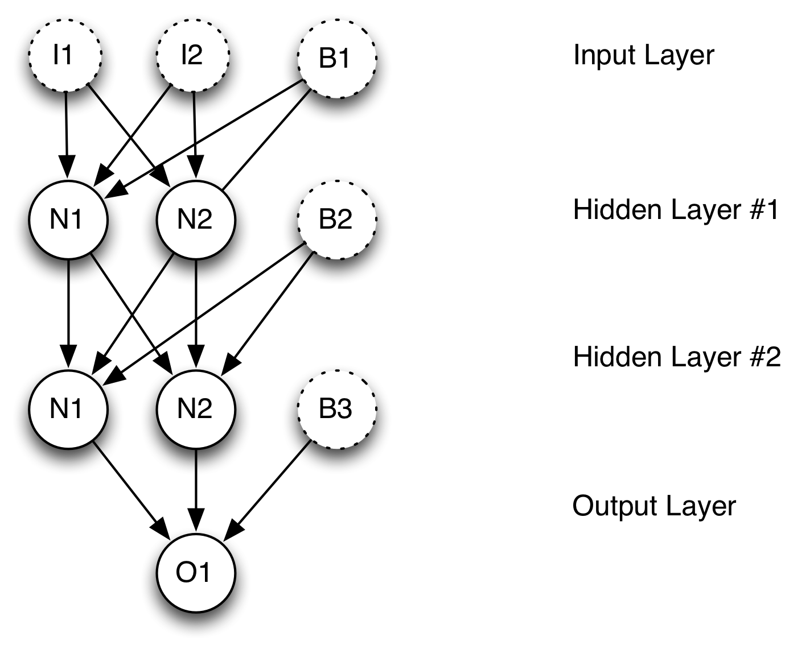
Dense Layers

Slide 35
Example: Naive Forecast
https://tinyurl.com/26dcemr3

Slide 36
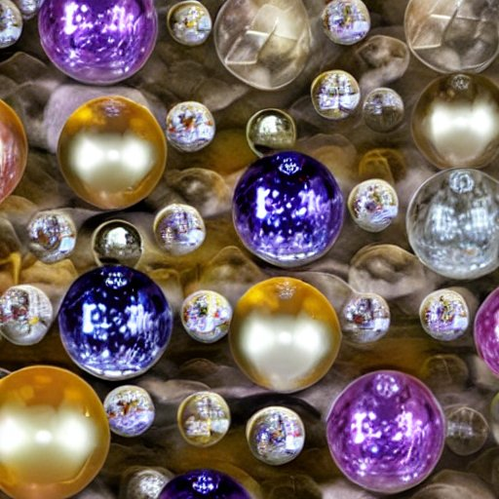
Seasonality & Trend Aware Forecast
Convolutional Neural Network
Additional features
Sales volume
Day of week (new)
Day of year (new)

Slide 37
Seasonality & Trend
Terminology
Level: The values being predicted with trend, seasonality & noise removed.
Trend: An underlying generally monotonically increasing or decreasing value in the series.
Seasonality: One or more short term cycles in the data.
Noise: Random and unpredictable variation in the series.

Slide 38
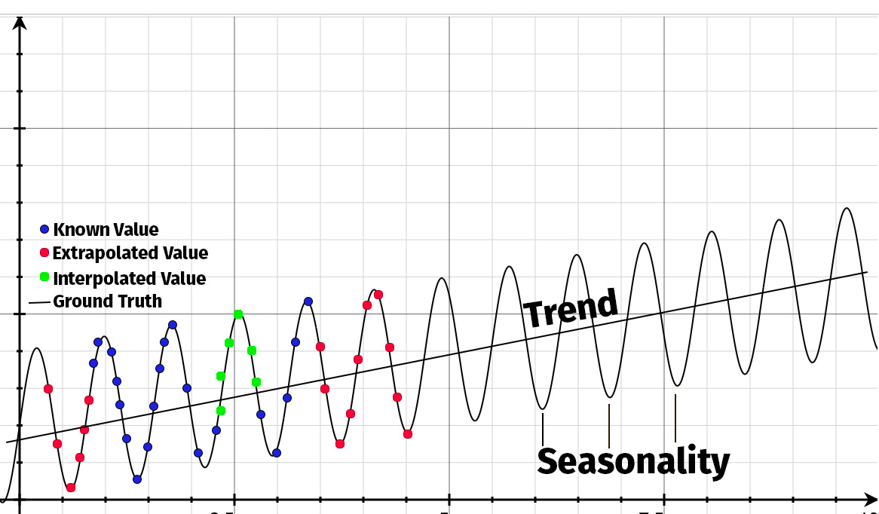
Interpolation, Trend, & Seasonality

Slide 39
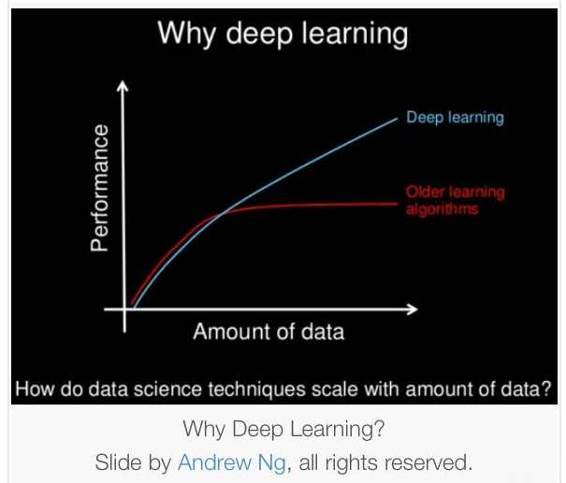
Always be Leary of Trends

Slide 40

Calendars Introduce Much Complexity
Not every year has the same number of days.
The 9th day of the year could be any of the days of the week.
Holidays are at best demand dips/spikes, at worst outliers.
Holiday occurrence is a mix of solar, lunar, and societal constructs.
Other outliers may not be holidays.

Slide 41
Always Remember about Neural Networks
Neural networks CAN interpolate.
Neural networks are great for time series.
However!
Neural networks cannot extrapolate.
Neural networks do not handle seasonality.
Neural networks do not handle trends (at least not completely).
Multi-layered seasonality is even more difficult.
This dataset has ALL of these!

Slide 42
Engineered Features
Day of year
Day of week

Slide 43

Seasonal Neural Network Structure

Slide 44
Example: Seasonality Aware Forecast
https://tinyurl.com/26dcemr3

Slide 45
Lab #2: Feature Engineering
https://tinyurl.com/26dcemr3

